Slide 1
University Eligibility Checking System

Slide 2
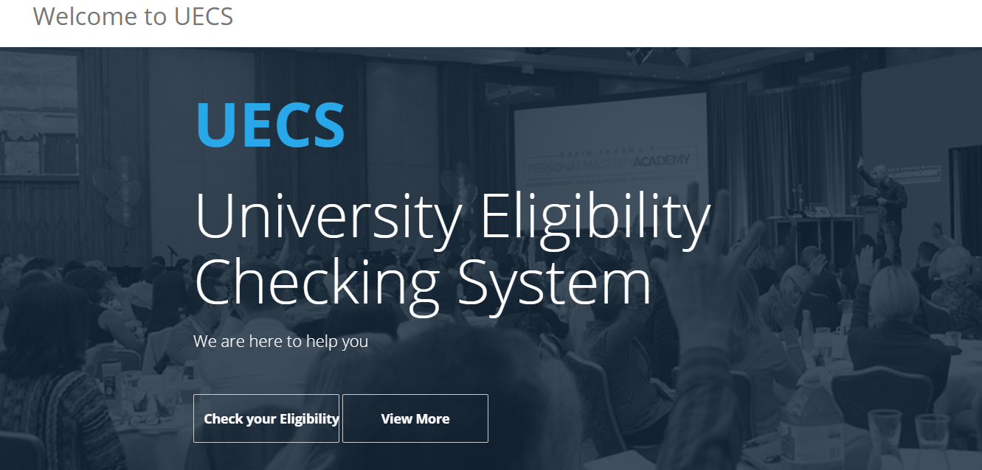
Main User Interface

Slide 3
Introduction
We will design a website for the government sector including all the eligible degree programs related to each range of Z-scores and the universities which offered the selected degree program providing user friendly interface for its users.

Slide 4
Functional Requirements

Slide 5
Functional Requirements
• Select and give the list of degree courses which student can apply.
• Output degree(s) most probable to be selected into.
• Provide Universities that provide that degree.
• Display degree contents and job fields.

Slide 6
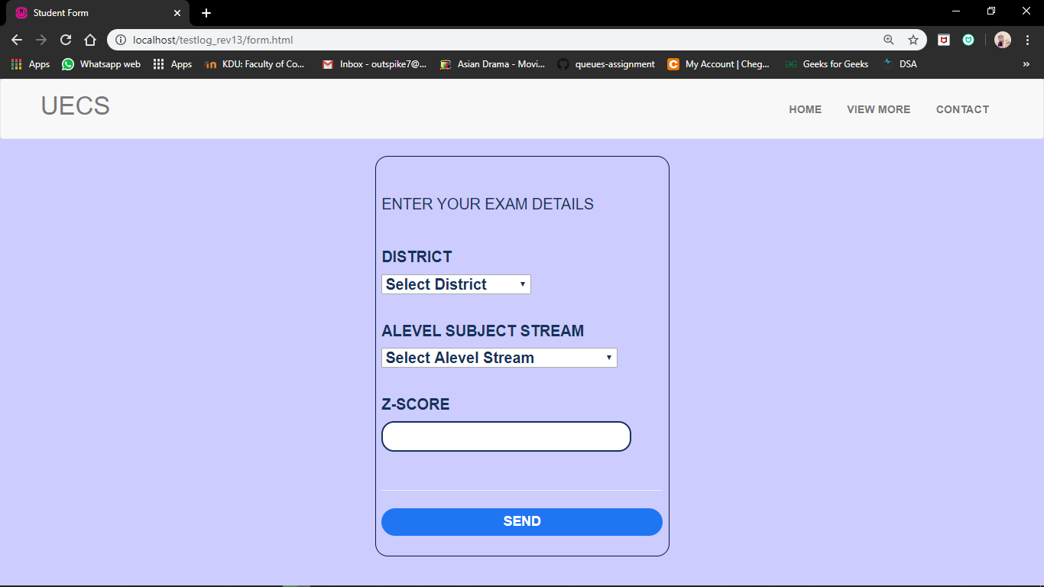

Slide 7
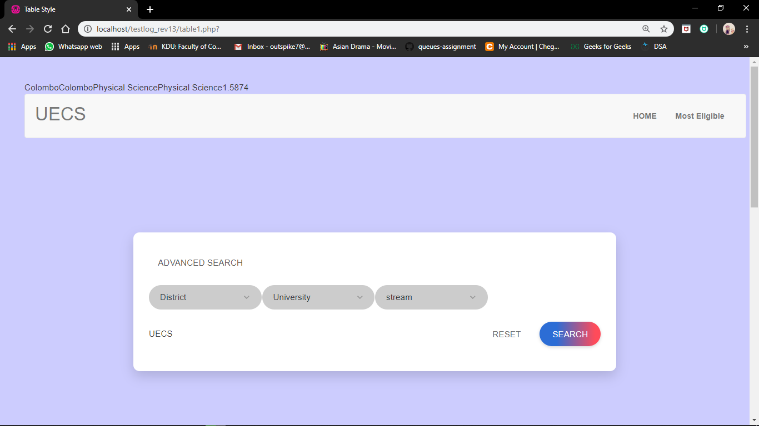

Slide 8
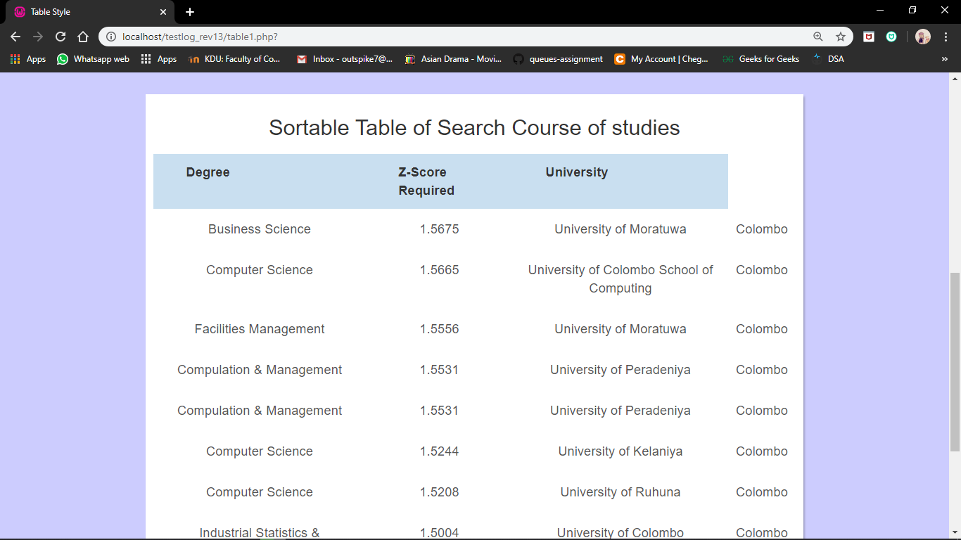

Slide 9
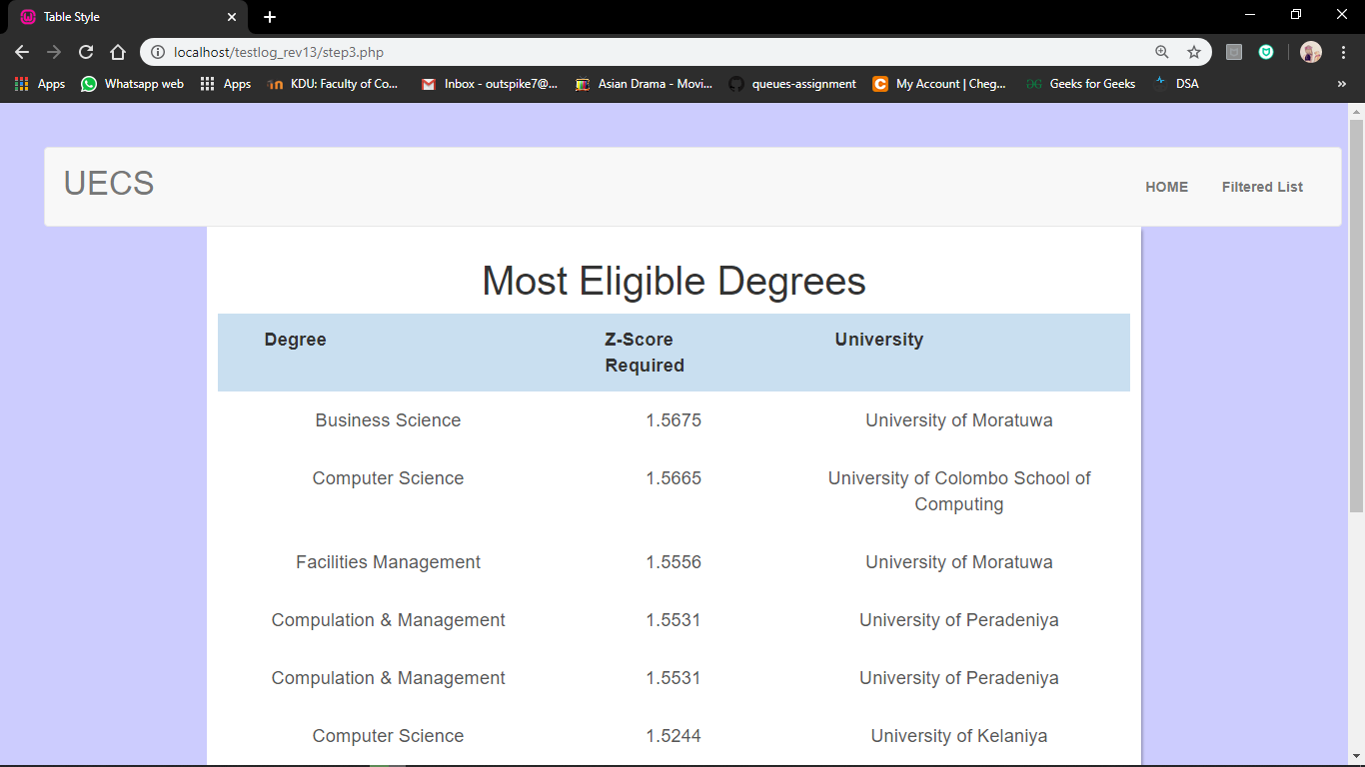

Slide 10
HCI Failures
Screen/Interface
Alignments, layouts, colors. New users might have a difficult time navigating
Interactions
Before: The user was redirected to the homepage to proceed to the next step they would like.
After: We redirected the user directly to the following step after data entry
and eliminated the steps thereafter by adding filters and search bars and simplifying the process.
The UGC denied us access to their database records which compelled us to enter data into the system manually which took a considerable amount of time
Maintainability issue
This meant updating the database would need manual input, annually.

Slide 11
Non-functional Requirements

Slide 12
Non-Functional Requirements
• Brief introduction about courses
• Security and privacy
• User friendly interface
• Flexible technology

Slide 13
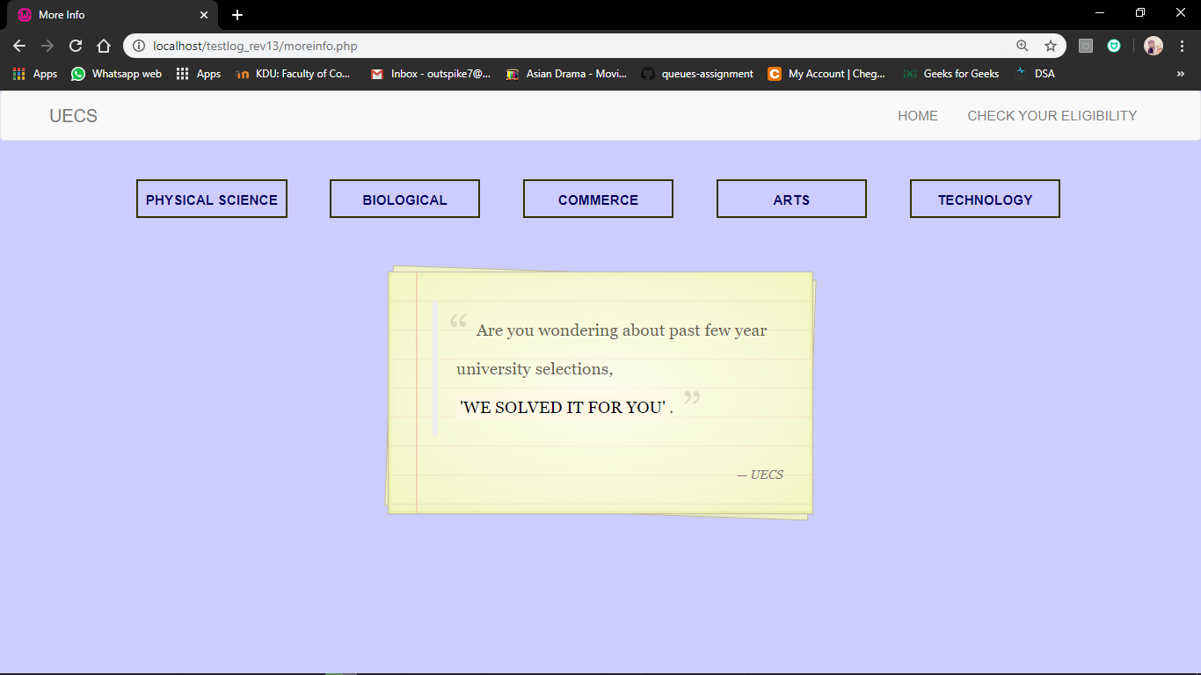

Slide 14
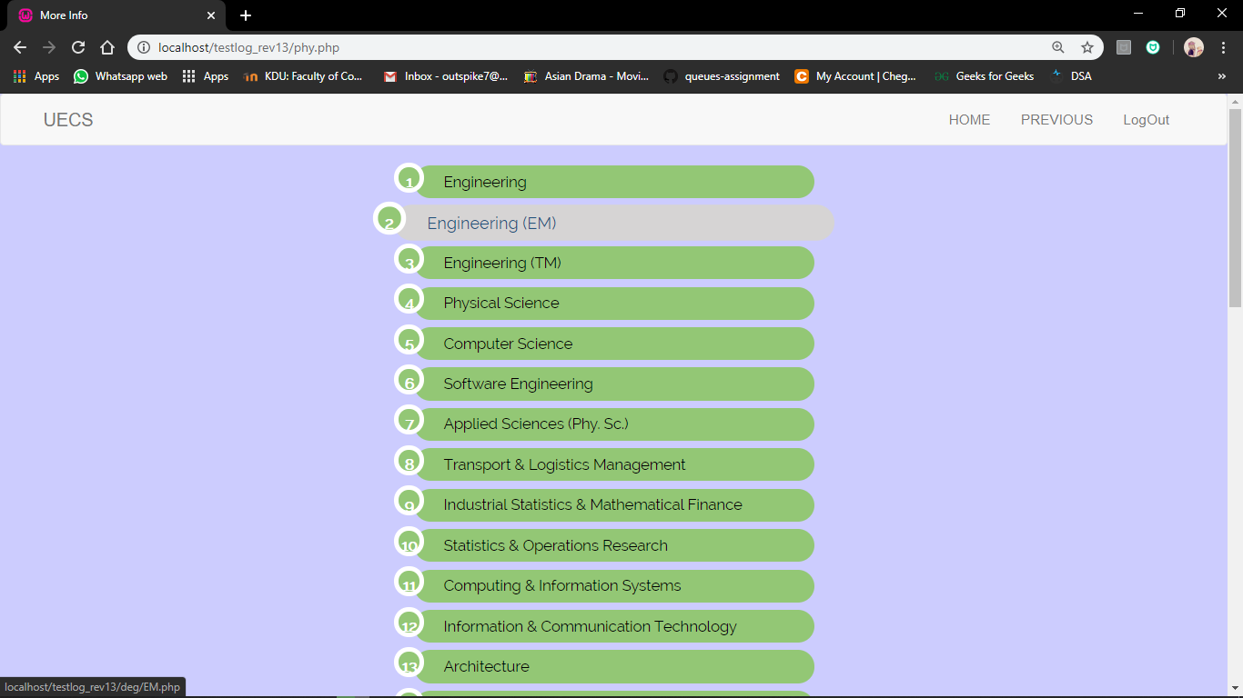

Slide 15

Objective
Giving students the ability to know beforehand if they have the chance of being selected into a government university, it would help greatly in making future decisions. Our website does just that by taking user Streams and Z-scores and providing them with their eligible degree programs and showing them all the options, they have to start their careers.

Slide 16
Team Members
D/CE/18/0005 A.B.T.M.A.S.A.Bandaranaike D/CS/18/0009 D.A.Iddamalgoda
D/CS/18/0015 B.L.A.Kalhari
D/CE/18/0018 I.W.M.H.D.Bandara

